Slide 1



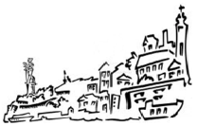
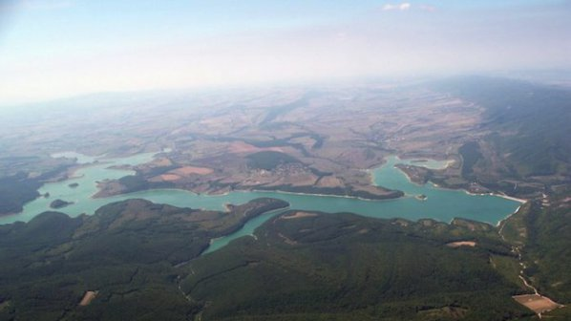
ASSESSMENT OF CURRENT AND FUTURE DRINKING WATER QUALITY VULNERABILITY UNDER ANTICIPATED CLIMATE CHANGES ON A WATERSHED LEVEL
Emiliya Velizarova¹, Snezana Balabanova², Ivan Marinov¹
¹Forest Research Institute – BAS
² National Institute of hydrology and meteorology

Slide 2



Mitigating Vulnerability of Water Resources
under Climate Change
CC – WARE
2013 - 2014
WP3: Vulnerability of Water Resources in SEE
WP4: Management options for mitigating vulnerability of drinking water resources

Slide 3

CURRENT AND FUTURE DRINKING WATER QUALITY VULNERABILITY
There are research gaps related to drinking water quality and climate change
The purpose of the present study was to assess the current and make predictions on future drinking water quality vulnerability in the watershed level of the Ticha lake under anticipated climate changes.
The recent prolonged drought observed in different regions of Bulgaria has affected the surface water resources.
The extreme rain events could cause flooding and thus deterioration of the water quality.
About 22% (1/4) of the total water volume of all 54 dams in Bulgaria are used for drinking and house-water supply.

Slide 4

Water resources from forests
ecosystem goods and services
direct - 'provisioning' functions
indirect - 'regulatory' and 'supportive' functions
Water resources from forests are already in use for drinking water purposes in several regions and in a number of the major European cities
Climate change is considered as the biggest environmental threat –
further annual river flows are projected to decrease in many parts of southern and south‐eastern Europe
Droughts and water stress will increase in the summer season, thus changing the quantity and quality of the available water resources

Slide 5
Water resources from forests
Water Framework Directive (WFD)
European Union Commission's Blueprint
concept for sustainable water use
Water use needs to be integrated into the ongoing implementation of relevant documents - such as climate change, biodiversity, energy, transport
The climate change could influence directly or indirectly the quality and quantity of the water resources through changes of the life cycles of biological species and ecosystems, their vegetation period and physiology
The erosion intensification, flooding, etc. affect the hydrological regime of forest watersheds – water flows

Slide 6
CURRENT AND FUTURE DRINKING WATER QUALITY VULNERABILITY
Vulnerability is an essential concept in climate change measures as its assessment through indicators provides authorities by single indexes that can be applied by managers
‘Water vulnerability' – when different pressures, exposing water ecosystems to shortages and excesses of water (EEA, 2012)
Vulnerability of the surface water quality is mainly due to the change the use of land, which is related to climate, hydrology and water resources management.
The WFD concept is based on the river catchments, where the main purpose is that water bodies should be restored to a good ecological and chemical status

Slide 7
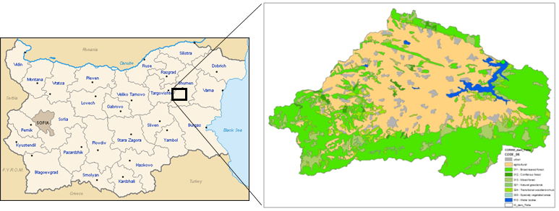
Studied area
Main characteristic of the watershed of the Ticha lake (reservoir)
It situates within the area of the Black Sea Basin Directorate (BSBD) – Varna.
Location of the watershed of the Ticha lake
Based on the altitude typology – it is mid-altitude (from 200 to 800 m), depth (> 15 m) and is spread on an area of more than 10 km²
The Ticha lake is one of the four dаms used for drinking water supply of the 142 572 habitants. The water volume is about 311 million m³.

Slide 8
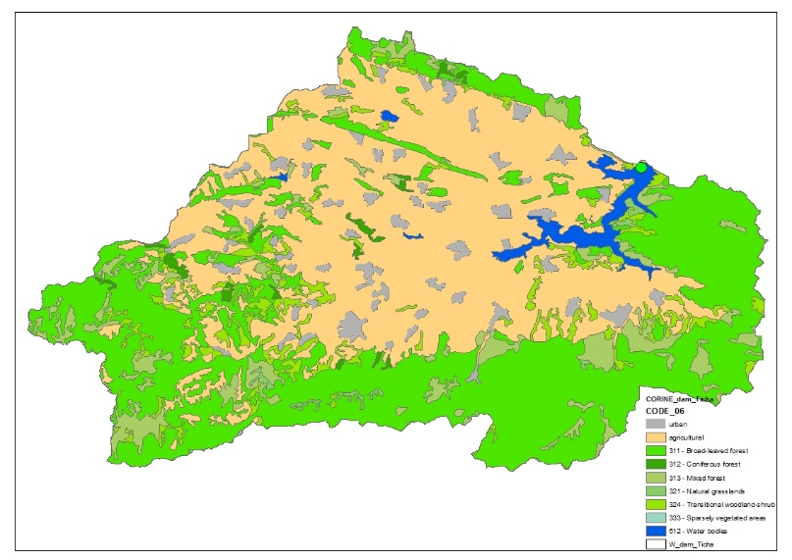
Estimation of the surface water quality vulnerability – methodology
Water Quality Index (WQI) - is equal to Normalized pollution load values, according to Wochna et al. (2011)
The core data set for the calculation of WQI of „vulnerability“ is the CORINE land use data set for 2006
Location of the watershed of the Ticha lake
The proposed pollution indices PLIj for each class of the CORINE land cover for 2006 are calculated taking into account export coefficients for nitrogen and phosphorus from diffuse sources of pollution, according to Wochna et al. (2011)
Vulnerability classes are as follows
< 0.2 – very low,
0.2 – 0.4 – low,
0.4 – 0.6 – moderate
0.6 – 0.8 – high
> 0.8 – very high

Slide 9
Estimation of the surface water quality vulnerability
CLC code | Future scenarios
 | WQIj_2050_S1 | WQIj_2050_S2 | WQIj_2050_S3 | WQIj_2050_S4 | WQIj_2050_S5
111 | 0.395 | 0.399 | 0.400 | 0.391 | 0.395
112 | 0.370 | 0.367 | 0.366 | 0.374 | 0.371
212 | 1.172 | 1.003 | 1.089 | 1.236 | 1.073
311 | 0.240 | 0.240 | 0.240 | 0.240 | 0.240
312 | 0.167 | 0.167 | 0.167 | 0.167 | 0.167
313 | 0.186 | 0.186 | 0.186 | 0.186 | 0.186
332 | 0.100 | 0.100 | 0.100 | 0.100 | 0.100
Assessment for future land use scenarios of CORINE classification, has been performed by the European Environment Agency (EEA) in the project "Land use scenarios for Europe: qualitative and quantitative analysis on a European Scale (PRELUDE)" (EEA Technical Report no 9/2007).
The PRELUDE scenarios combine the assessment of changes in the bio-physical environment with simultaneous changes in the socio-economic environment

Slide 10
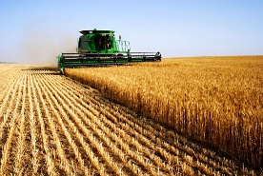
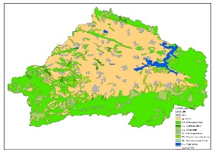
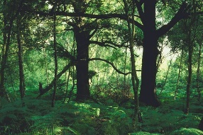
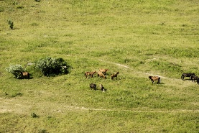
Results
Distribution of the watershed area of the Ticha lake according to the CORINE 2006
Potential source of the soil particles from the surface soil layer during cultivation
Land cover according to the CLC 2006 |  | Area, ha
CLC code | CLC description
- | All urban | 4000
- | All agricultural | 40386
311 | Broad-leaved forest | 38162
312 | Coniferous forest | 768
313 | Mixed forest | 6619
321 | Natural grasslands | 478
324 | Transitional woodland-shrub | 5323
333 | Sparsely vegetated areas | 1
512 | Water bodies | 1959
 | Total for watershed | 97696
(41%)
The water body directly borders the agricultural areas
used for grazing and therefore could be threatened by vegetation destruction

Slide 11
Results
Quality of water used for drinking supply
CLC class code | CLC description | PLIj, relative index of pollution Load 2006 (or Nitrogen exported coefficient) | WQIj (normalized index of Pollution load 2006)
111 | Continuous urban fabric | 6 | 0.400
112 | Discontinuous urban fabric | 5.5 | 0.367
212 | Permanently irrigated land | 15 | 1.000
311 | Broad-leaved forest | 3.6 | 0.240
312 | Coniferous forest | 2.5 | 0.167
313 | Mixed forest | 2.8 | 0.187
332 | Bare rocks | 1.5 | 0.100
For each CORINE land use class (CLC) at LEVEL 3 an overall water pollution load index (PLI) was assumed to be proportional to nutrients export coefficients from a given land use territory.
Nitrogen and Phosphorous export coefficients have been assumed as diffuse sources of pollution (Wochna et al., 2011)

Slide 12
Quality of water used for drinking and household supply for small watersheds
Area distribution of small river watersheds in % of total river Ticha lake according to CLC class codes
With low vulnerability to water quality pollution - are areas covered mainly with deciduous trees spread on 64.2% of the territory
CLC class code | WQIj (normalized index of Pollution load 2006) | River watersheds, in % total river Ticha lake according to CLC class codes
 |  | Kamchia to village Ticha | Draganovska | Eleshnitsa | Gerila | Gurla | Whole Ticha
all urban | 0.375 | 0.78 | 5.20 | 1.80 | 3.80 | 7.18 | 4.09
all agricultural | 0.499 | 11.74 | 66.07 | 15.71 | 40.91 | 72.18 | 41.34
311 | 0.240 | 64.24 | 19.22 | 63.46 | 46.59 | 13.03 | 39.06
312 | 0.167 | 1.66 | 0.75 | - | - | 1.86 | 0.79
313 | 0.187 | 15.06 | 3.03 | 11.38 | 0.58 | 2.60 | 6.78
321 | 0.167 | 0.18 | 0.33 | 0.25 | 6.44 |  | 0.49
324 | 0.173 | 7.14 | 4.43 | 5.92 | 1.38 | 2.47 | 5.45
333 | 0.133 | - | - | - | - | -
512 | 0.200 | - | 0.98 | 1.47 | 0.30 | 0.68 | 2.01
The highest water quality pollution index - 0.499 was calculated for the territory with agricultural type of lands use

Slide 13
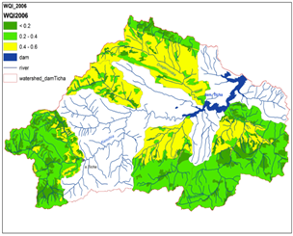
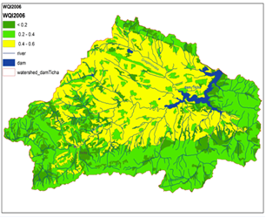
Spatial distribution of areas of the watershed of the Ticha dam in relation to the vulnerability of quantity and quality of water for drinking and household supply
Water quality vulnerability indices WQI 2006 for small watersheds within the watershed of the Ticha lake
Water quality vulnerability of indices WQI 2006 for the whole watershed of the Ticha lake
scale for vulnerability:
< 0.2 – very low,
0.2 – 0.4 – low,
0.4 – 0.6 – moderate
Low vulnerable in relation to water quantity is 43.2 % of the territories - mainly areas with deciduous trees.
A moderately vulnerable, in terms of quantity and quality, is the area around the lake ‘41.3% .

Slide 14
WQI values for the entire watershed of the Ticha for future scenarios
Watershed | Code | Vulnerability
 |  | WQI 2006 | WQI_2050 S1 | WQI 2050 S2 | WQI 2050 S3 | WQI 2050 S4 | WQI 2050 S5
Ticha lake | all urban | 0.375 | 0.376 | 0.375 | 0.374 | 0.377 | 0.376
 | agricultural | 0.499 | 0.559 | 0.500 | 0.534 | 0.554 | 0.514
 | 311 | 0.240 | 0.240 | 0.240 | 0.240 | 0.240 | 0.240
 | 312 | 0.167 | 0.167 | 0.166 | 0.167 | 0.166 | 0.166
 | 313 | 0.187 | 0.186 | 0.186 | 0.186 | 0.186 | 0.186
 | 321 | 0.167 | 0.173 | 0.170 | 0.173 | 0.172 | 0.171
 | 324 | 0.173 | 0.173 | 0.173 | 0.173 | 0.173 | 0.173
 | 333 | 0.133 | 0.134 | 0.133 | 0.133 | 0.133 | 0.133
 | 512 | 0.200 | 0.200 | 0.200 | 0.200 | 0.200 | 0.200
The WQI values were calculated depending on defined scenarios for land use change in 2050. S1 - Great Escape, S2 - Evolved Society, S3 - Clusters of European Networks, S4 - Lettuce Surprise, S5 - After the Big Crisis
The prevision is that over the forecast period - 2020 – 2050, this area will enter into the category of highly vulnerable in relation to the water quantity, while in terms of quality vulnerability - it will remain unchanged (at the same category vulnerability). 0.4 – 0.6 – moderate

Slide 15
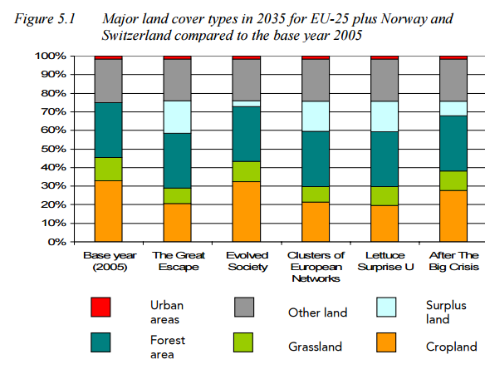
Axel Volkery, Ybele Hoogeveen, M. Teresa Ribeiro
European Environment Agency
Prospective Environmental Analysis of Land-Use Development in Europe: Understanding the problem and searching for robust long-term strategies
2006 Berlin Conference on the Human Dimensions of Global Environmental Change

Slide 16
Conclusions
According to the calculated WQI values of water quality vulnerability for the watershed of the Ticha lake,
43.2% of the area is with values within the “low vulnerability” category (WQI is within the range of 0.2 – 0.4.
Moderately vulnerable are 41.3% of the territory (WQI is between 0.4 – 0.6),
while 2% of the territory is with a “very low vulnerability” (WQI is less 0.2).
The calculated WQI values for future scenarios WQI_2050 S1 to WQI_2050 S5 in relation to land use changes show negligible differences and WQI values remaining in the same vulnerability classes.

Slide 17
