Slide 1

training & research
for academic newcomers
A project of the King Baudouin Foundation
Notes:
Please use this slide at the beginning of your presentation.
Background color: red-120; green-150; blue-150; transparancy-80%

Slide 2

Module 3
Preparing Funding Applications & Project Management
Gabriella Calderari
David W Chadwick
Notes:
Second slide.

Slide 3
Proposals Evaluation
Notes:
If you want you can use this template for you presentation, see potx-file.

Slide 4
Project A

Slide 5
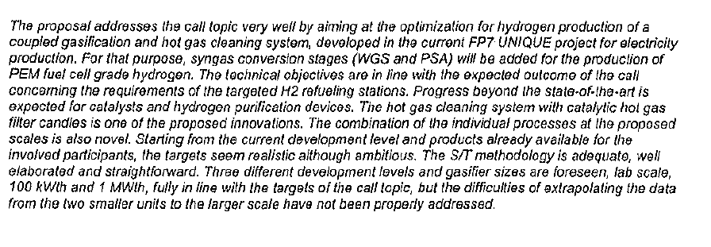
1- scientific or technological excellence

Slide 6
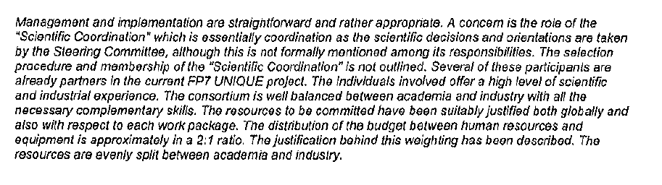
2- Quality and efficency of the implementation and the management

Slide 7
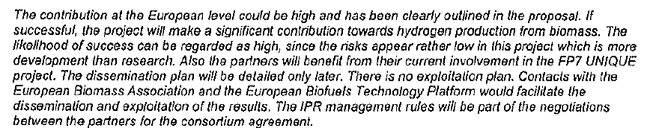
3- Potencial impact through the development, dissemination and use of project results

Slide 8

EVALUATION CRITERIA
1- scientific or technological excellence 4
2- Quality and efficency of the implementation and the management 4
3- Potencial impact through the development, dissemination and use of project results 3,5
TOT 11,5

Slide 9
Project B

Slide 10
1- scientific or technological excellence
Evaluators' comments
The main concept of X is to increase the use of SDIs and new approaches to measure progress towards SD and to make use of sectoral policies analysis which is a new and innovative approach. The project is ambitious. The concept is sound and the objectives are good as well.
The description of the present state of the art is comprehensive but its quality is uneven between the different parts.
The work plan is in some parts imprecise and contains inconsistencies in the work packages' description. For example, WP2 is studying knowledge brokerage-methods (KB), while WP3 is applying a predefined particular method of KB. The in-built evaluation is included.
Strong emphasis is given to mapping existing SDI sets but it is not convincingly spelled out how much of this work goes beyond the state-of-the-art.

Slide 11
2- Quality and efficency of the implementation and the management
Evaluators' comments
The management structure and procedures are generally good as they are explained in some detail, but a diagram clarifying the structure would have been helpful.
Some of the institutes are leading institutes in the field of SD and individual members are well equipped in performing these tasks, many of them have been involved in earlier FP research activities. There is little evidence of commitment of partners from policy makers and other stakeholders.
The overall level of resources is reasonable, but the distribution among WPs is not convincing, with very little resources devoted to the central WP2 and comparatively much for WP5.

Slide 12
3- Potencial impact through the development, dissemination and use of project results
Evaluators' comments
The potential impact on knowledge transfers in academia is good. However, the proposal does not convincingly explain how the proposed work will reach out to the policy arena. The influence on the policy-arena and other stakeholders seems to be limited. The proposal also does not address impacts or activities beyond the duration of the project.
The dissemination plan as such is not sufficiently explained, in particular when judged against the resources allocated for this activity.
Intellectual property right issues are properly discussed.

Slide 13

Project B
CRITERIA
1- scientific or technological excellence 3
2- Quality and efficency of the implementation and the management 3
3- Potencial impact through the development, dissemination and use of project results 3
TOT 9

