Slide 1

training & research
for academic newcomers
A project of the King Baudouin Foundation
Notes:
Please use this slide at the beginning of your presentation.
Background color: red-120; green-150; blue-150; transparancy-80%

Slide 2

Overview of EU Programmes
Gabriella Calderari
David Chadwick
Notes:
Second slide.

Slide 3
Overview
Funding schemes/instruments in FP7
Collaborative projects
Network of Excellence
Coordination & support actions
Marie Curie
European Research Council
Joint Technologies Initiative
Horizon 2020

Slide 4

European Commission
The European Commission (EC) is the executive body of the European Union responsible for proposing legislation, implementing decisions, upholding the Union's treaties and day-to-day running of the EU.
EC awards money in the form of grants in order to implement projects or activities in relation to European Union policies.

Slide 5

Grants are subject to annual or multi-annual programming:
WORK PROGRAMMS (WP)
Within WP, Managing Authorities publish
CALLS FOR PROPOSALS
inviting candidates to present, within a given deadline, a proposal for action that corresponds to the objectives pursued and fulfils the required conditions.

Slide 6
European Commission Key Policy
The EU 2020 Strategy (replaces the Lisbon Strategy)
Commission's new 10 year strategy aimed at making the EU more dynamic and competitive
THREE KEY DRIVERS:
    Smart growth, sustainable growth and inclusive growth
SEVEN FLAGSHIP INITIATIVES:
    ‘Innovation Union’
    ‘Youth on the move’
    ‘A digital agenda for Europe’
    ‘Resource efficient Europe’
    ‘An industrial policy for the globalization era’
    ‘An agenda for new skills and jobs’

Slide 7

The 7th Framework Programme
FP7 is the EU funding programme for research and technological development for the years 2007-2013
The 7th Framework Programme main funding schemes:
  Cooperation
  Capacities
  Ideas: European Research Council (ERC)
  People: Marie Curie

Slide 8
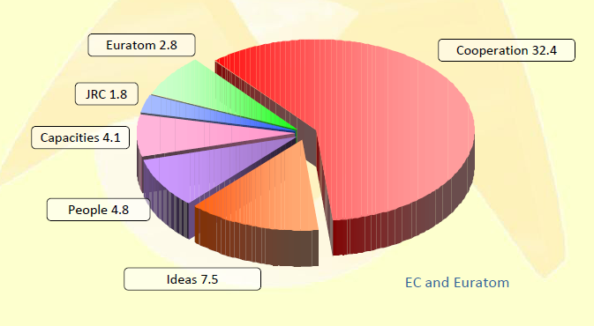
7FP Budget
50 M EUR

Slide 9
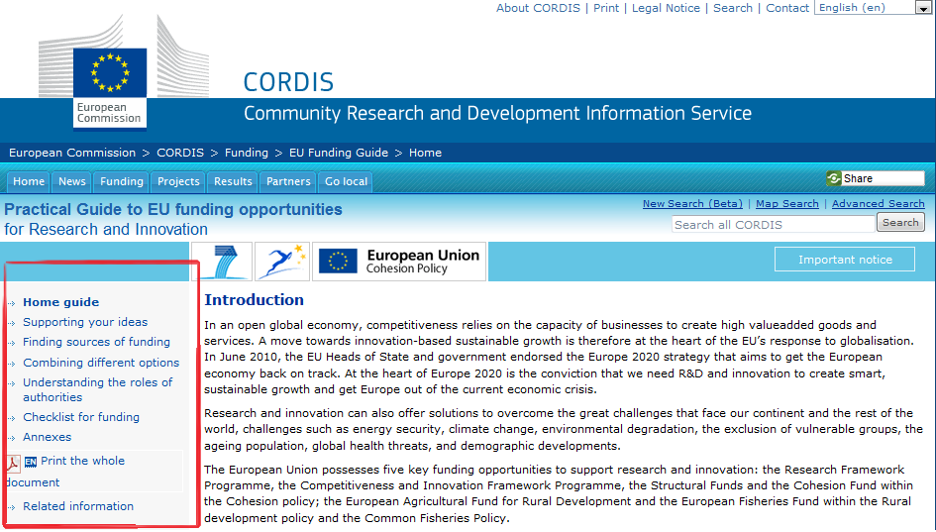
CORDIS
Community Research and Development Information Service
http://cordis.europa.eu/home_en.html

Slide 10
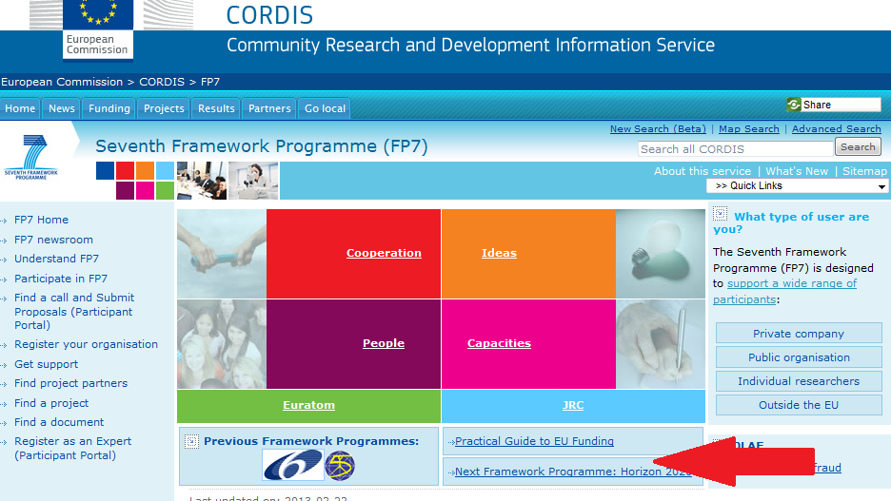
Practical guide to EU Funding
http://cordis.europa.eu/eu-funding-guide/home_en.html

Slide 11
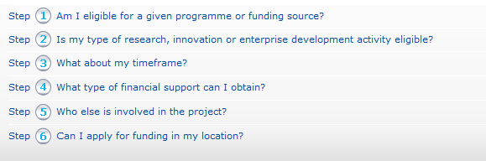
Checklist for EU innovation and research funding

Slide 12
Cooperation
The specific programme on 'Cooperation' supports all types of research activities carried out by different research bodies in trans-national cooperation and aims to gain or consolidate leadership in key scientific and technology areas.
THEMES
Health
Food, Agriculture, fisheries, & Biotechnology
ICT
Nanosciences, Nanotechnologies, Materials, & New Production Technologies
Energy
Environment (including Climate Change)
Transport
Socio-Economic Sciences & Humanities
Space
Security
Across all these themes, support to trans-national cooperation will be implemented through:
Collaborative research: European Excellence
Coordination between national research programmes
Joint Technology Initiatives
Technology Platforms

Slide 13
WHO CAN PARTICIPATE
EU-28
Austria, Belgium, Bulgaria, Cyprus, Croatia, Czech Republic, Denmark, Estonia, Finland, France, Germany, Greece, Hungary, Italy, Ireland, Latvia, Lithuania, Luxemburg, Malta, Netherlands, Poland, Portugal, Romania, Slovakia, Slovenia,
Spain, Sweden, UK
Associated Countries (FP7)
Albania*, Bosnia and Herzegovina *, Croatia*, Faroe Islands*, FYR, Macedonia*, Iceland*, Israel*, Liechtenstein*, Montenegro*, Norway*, Serbia*, Switzerland, Turkey*,
*except Euratom

Slide 14
FUNDING INSTRUMENTS
Collaborative Projects (CP)
– Small or medium scale focused research actions (“STREP”)
– Large Scale Integrated Projects (“IP”)
Networks of Excellence (NoE)
Coordination and Support Actions (CSA)
– Coordinating or networking actions (“CA”)
– Support Actions (“SSA”)

Slide 15
Research aiming at developing new
knowledge, new technology,
products, demonstration activities or
common resources for research
Collaborative Projects (CP)
CP – Integrated Projects (IPs) activities in an Integrated Project
– research and technology development activities
– demonstration activities
– technology transfer or take-up activities
– training activities
– dissemination activities
– knowledge management and exploitation
– consortium management activities
– other activities

Slide 16
Collaborative Projects (CP)
CP – Focused projects (STREPs)
Targeting a specific objective in a clearly defined project and work plan with stable deliverables that do not change over the life-time of the project.
ACTIVITIES:
• Research and technological development activity designed to generate new knowledge to improve competitiveness and/or address major societal needs
• Demonstration activity designed to prove the viability of new technologies offering potential economic advantages but which can not be commercialised directly(e. g. testing of product like prototypes)
Other Activities such as Project management (including innovation related activities like protection of knowledge) dissemination and exploitation

Slide 17
Integrating Projects (IP)
IPs specifically aim at fostering European competitiveness in basic research and applied science with a focus on "addressing major needs in society" defined by the Priority Themes of the Framework Programme. Like STRePs, IPs ask for a strong participation of small or medium-sized enterprises (SMEs) to ascertain the translation of research results into commercially viable products or services.

Slide 18
Networks of excellence (NoEs)
NoEs are an instrument to overcome the fragmentation of the European research landscape in a given area and remove the barriers to integration.
Their purpose is to reach a durable restructuring and integration of efforts and institutions or parts of institutions.
The success of an NoE is not measured in terms of
scientific results but by the extent to which the social fabric for researchers and research institutions in a field has
changed due to the project, and the extent to which the existing capacities become more competitive as a result of this change.

Slide 19
Networks of Excellence (NoEs)
The main activities of an NoE are:
  coordinated programming of the partners’ activities
  sharing of research platforms/tools/facilities
  joint management of the knowledge portfolio
  staff mobility and exchanges
  relocation of staff, teams, equipment
  reinforced electronic communication systems
  training researchers and other key staff
  dissemination and communication activities
  networking activities to help transfer knowledge
  where appropriate, promoting the exploitation of the results generated within the network
  where appropriate, innovation-related activities
  (project management)

Slide 20
Coordination or Networking Actions (CAs)
Designed to promote and support the ad hoc networking
and co-ordination of research and innovation activities at
national, regional and European level over a fixed period for a specific purpose by establishing in a coherent way coordinated initiatives of a range of research and innovation operators, in order to achieve improved cooperation of the European research.
May combine the following two types of activities
– Co-ordination activities
– Consortium management activities

Slide 21
Coordination or Networking Actions (CAs)
Example of coordination activities:
– Organisation of events (conferences, meetings);
– Performance of studies, analysis;
– Exchanges of personnel;
– Exchange and dissemination of good practice;
– Setting up of common information systems
– Setting up of expert groups;
– Definition, organization, management of joint or common initiatives
– Management of the action

Slide 22
Support Actions (SAs)
SA proposals may be presented by a consortium or a
single organisation, from any country or countries
They are designed to help in preparations for future Community research and technological development policy activities, stimulate, encourage and facilitate the participation of
SMEs, civil society organizations, small research teams,
newly developed and remote research centre, as well as
setting up research clusters across Europe. Sas can also cover one off events or single purpose activities.
May combine the following two types of activities
– Support activities
– Consortium management activities

Slide 23
Support Actions (SAs)
Each Support Action shall have a work plan, which may
consist of one or more of the following support activities:
– Conferences, seminars, working groups and expert
groups;
– Studies, analysis;
– Fact findings and monitoring;
– Preparatory technical work, including feasibility studies
– Development of research or innovation strategies;
– High level scientific awards and competitions;
– Operational support, data access and dissemination,
information and communication activities.

Slide 24
Maximum EC reimbursement rate per action
 | FP7: Industry | FP7: Public Bodies, Universities, SMEs, etc.
RTD* | 50% | 75%
Demonstration | 50% | 50%
Management |  | 100%
Other** | 100% | 100%
ERC | 100% direct costs, plus 20% flat rate for indirect costs
Coordination Actions; Support Actions | 100% direct costs, plus up to 7% for indirect costs
Marie Curie Actions | Lump sum + flat rates, some actions 10 % for indirect costs
* Activities directly aimed at creating new knowledge, new technology, and products, including scientific coordination.
** Training, Consortium Management

Slide 25
CAPACITIES
The Commission’s proposals for the FP7 Capacities programme aim to:
enhance research and innovation capacities throughout Europe and ensure their optimal use;
support the coherent development of policies;
complement the Cooperation programme;
contribute to EU policies and initiatives to improve the coherence and impact of Member States policies;
find synergies with regional and cohesion policies, the Structural Funds, education and training programmes and the Competitiveness and Innovation programme (CIP).
Research Infrastructures
Research for the Benefit
Of SMEs
THEMES
Regions of Knowledge
Research Potential
Science in Society
Activities of International
Co-operation
Coherent Development
of Policies

Slide 26
PEOPLE - “MARIE CURIE” ACTION
Mobility actions for structuring training, mobility and career development
The aim of the programme is to make Europe more attractive to researchers ,structuring effect on the European Research Area through transnational and intersectoral mobility in order to create a European labour market for researchers
INITIAL TRAINING OF RESEARCHERS
LIFELONG LEARNING AND CAREER DEVELOPMENT
THEMES
INDUSTRY-ACADEMIA PARTNERSHIPS AND PATHWAYS
THE INTERNATIONAL DIMENSION
SPECIFIC ACTIONS

Slide 27
PEOPLE - “MARIE CURIE” ACTION
Objectives:
Strengthening the human potential in R&D in Europe
Stimulate people to enter into the profession of researcher
Encouraging researchers to stay in Europe
Attracting researchers from around the world
Addressed to researchers at all stages of their careers
Encouraging people to become researchers

Slide 28
PEOPLE - “MARIE CURIE” ACTION
'INITIAL TRAINING OF RESEARCHERS” to improve mostly young researchers' career perspectives in both public and private sectors, by broadening their scientific and generic skills, including those related to technology transfer and entrepreneurship.
'LIFE-LONG TRAINING' to support experienced researchers in complementing or acquiring new skills and competencies or in enhancing inter/multidisciplinarity and/or intersectoral mobility, in resuming a research career after a break and in (re)integrating into a longer term research position in Europe after a trans-national mobility experience.
'INDUSTRY-ACADEMIA PATHWAYS AND PARTNERSHIPS' to stimulate intersectoral mobility and increase knowledge sharing through joint research partnerships in longer term co-operation programmes between organisations from academia and industry, in particular SMEs and including traditional manufacturing industries.

Slide 29
PEOPLE - “MARIE CURIE” ACTION
'INTERNATIONAL DIMENSION', to contribute to the life-long training and career development of EU-researchers, to attract research talent from outside Europe and to foster mutually beneficial research collaboration with research actors from outside Europe.
'RESEARCHERS' NIGHT' is an event bringing together the public at large and researchers. It occurs annually on the fourth Friday of September all over Europe. Its main objective is to reveal scientists and science in a relaxed and friendly atmosphere.

Slide 30
IDEAS
The objective of the specific programme ‘Ideas’ is to reinforce excellence, dynamism and creativity in European research and improve the attractiveness of Europe for the best researchers from both European and third countries, as well as for industrial research investment, by providing a Europe-wide competitive funding structure, in addition to and not replacing national funding, for ‘frontier research’ executed by individual teams.
STARTING INDEPENDENT RESEARCHER GRANTS
THEMES
ADVANCED INVESTIGATOR GRANTS
CONSOLIDATOR GRANTS
SYNERGY GRANTS

Slide 31
EUROPEAN RESEARCH COUNCIL (ERC)
    Programme supporting a PI (Principal Investigator) and team members to develop frontier research across all fields of research, on the basis of scientific excellence.
  Supports the best in Europe - scientists, engineers and scholars
  Encourage highest quality research in Europe
  Excellence is the sole criterion
  Competitive, flexible funding
  Retain, repatriate and recruit (career support)

Slide 32
KEY POINTS FOR ERC GRANTS
Support for a PI and (if necessary) team-members
No need for collaboration with other countries
Team all usually based at the same institution (in EU/AC), but possible to have team members in other organisations if strongly justified (anywhere in World - not just EU, AC and ICPC)
Also for Advanced Grants can have a Co-I (must be from a different discipline to the PI)
No nationality or mobility requirements
Investigator driven (bottom-up) substantial advances “Frontier Research”
Excellence is only peer review criterion
Notes:
PI: project Investigator

Slide 33
ERC STARTING GRANTS
For researchers of any nationality with 2-7 years of experience since completion of PhD (or equivalent degree) and scientific track record showing great promise
An excellent research proposal
Research must be conducted in a public or private research organization (known as a Host Institution /HI) located in one of the EU Member State or Associated Countries
Funding per grant: up to € 1.5 million (in some circumstances up to € 2 million)
Duration: up to 5 years
Evaluation criterion: scientific excellence
Calls for proposals: published once a year

Slide 34
ERC CONSOLIDATOR GRANTS
For researchers of any nationality with 7-12 years of experience since completion of PhD (or equivalent degree) and scientific track record showing great promise
An excellent research proposal
Research must be conducted in a public or private research organisation (known as a Host Institution /HI) located in one of the EU Member State or Associated Countries
Funding per grant: up to € 2 million (in some circumstances up to € 2.75 million)
Duration: up to 5 years
Evaluation criterion: scientific excellence
Calls for proposals: published once a year

Slide 35
ERC ADVANCED GRANTS
Research field: any field of science, engineering and scholarship
Researchers: any nationality, any age. Applicants must be scientifically independent and have a recent research track-record and profile which identifies them as leaders in their respective field(s) of research
Evaluation Criterion: scientific excellence
Host Institution: research must be conducted in a public or private research organisation (known as a Host Institution /HI) located in one of the EU Member States or Associated Countries
Funding: up to € 2.5 million per grant (in some circumstances up to € 3.5 million per grant)
Duration: up to 5 years
Calls for proposals: published once a year

Slide 36
ERC SYNERGYGRANTS
Groups applying for the ERC Synergy Grant must be made up of a minimum of two and a maximum of four Principal Investigators (PIs) and, as necessary, their teams
No specific eligibility criteria are foreseen for PIs applying for the ERC Synergy Grants, but only exceptional proposals are likely to be funded in what are expected to be extremely competitive calls
It is expected that in most cases ERC Synergy Groups will be interdisciplinary, often using multidisciplinary approaches. However this is not a requirement and colleagues from the same or similar disciplines bringing together complementary approaches, expertise and resources can apply
The Host Institution that engages the Corresponding Principal Investigator for the duration of the grant should be a legally recognized public or private research organisation situated in one of the EU Member States or Associated Countries
Funding: up to a maximum of €15 million for a period up to 6 years (pro rata for projects of shorter duration)
Calls for proposals: published annually with one deadline

Slide 37
TECHNOLOGY PLATFORMS
European Technology Platforms introduced in the Commission Communication on an Action Plan for 3% of GDP for research (2003)
Develop and drive forward coherent R&D strategies In strategic areas
Ramp up R&D investment in Europe Towards 3% (Barcelona Objective)
Bring together fragmented efforts
Building European Research Area
Article 171 Treaty
“The Community may set up joint undertakings or any other structure necessary for the efficient execution of Community research, technological development and demonstration programmes.”

Slide 38
Joint Technology Initiatives (JTI)
Arising from Technology Platforms
Formalized public-private partnerships
  Covering a focused set of R&D challenges
  Combining private and public (European and national) financial resources
  Legal basis: Article 171 of the Treaty
Criteria
  Very limited number of cases with huge challenges
  Inability of existing instruments to achieve objectives
  Impact on industrial competitiveness
  Strength of commitment from industry
  Capacity to attract additional national support and leverage industrial funding

Slide 39
Joint Technology Initiatives (JTI)
Body set up by the Community
Duration: till 31-12-2017
Seat: Brussels
Members: Industry, European Community, a set of Member States and Associated Countries
Objectives
  Define and implement a Research Agenda
  Support R&D activities (Calls for Proposals)
  Promote the public-private partnership (increase investments)
  Achieve synergy and coordination with other European R&D
  Promote the involvement of SME’s
ENERGY: FCH-JU
TRANSPORT: CLEAN SKY
HEALTH: IMI
ICT:ARTEMIS
ICT:ENIAC
Notes:
Energy – fuel cells hydrogen – joint undertaking
Transport – reducing aviation emissions
Health – The Innovative Medicines Initiative
Artemis - Advanced Research & Technology for EMbedded Intelligence and Systems
Eniac - public-private partnership focusing on nanoelectronics

Slide 40

What’s next?

Slide 41
Horizon 2020
Research and innovation funding programme (2014-20)
A single programme bringing together three separate programmes/initiatives:
  The 7th research Framework Programme (FP7),
  Innovation aspects of Competitiveness and Innovation Framework Programme (CIP),
  EU contribution to the European Institute of Innovation and Technology (EIT)
Foreseen fund allocation 80 billion euro

Slide 42
Horizon 2020 priorities
1 Excellent science
2 Industrial leadership
3 Societal challenges

Slide 43
RULES FOR PARTICIPATION
A SINGLE SET OF RULES
Adapted for the whole research and innovation cycle
Covering all research programmes and funding bodies
Aligned to the Financial Regulation, coherent with other new EU Programmes.
ONE PROJECT - ONE FUNDING RATE.
  Maximum of 100% of direct costs (except for actions close to market, where a 70% maximum will apply)
  Indirect eligible costs: a flat rate of 20% of direct eligible costs
SIMPLE EVALUATION CRITERIA
  Excellence – Impact - Implementation (Excellence only, for the ERC)

Slide 44
RULES FOR PARTICIPATION
NEW FORMS OF FUNDING aimed at innovation: pre-commercial procurement, inducement prizes, dedicated loan and equity instruments.
INTERNATIONAL PARTICIPATION: facilitated but better protecting EU interests.
FEWER, BETTER TARGETED CONTROLS AND AUDITS
Lowest possible level of requirements for submission of audit certificates without undermining sound financial management;
Audit strategy focused on risk and fraud prevention.

Slide 45
RULES FOR PARTICIPATION
IMPROVED RULES ON INTELLECTUAL PROPERTY
Balance between legal security and flexibility;
Tailor-made IPR provisions for new forms of funding;
A new emphasis on open access to research publications.
SIMPLER RULES FOR GRANTS: broader acceptance of participants accounting practices for direct costs, flat rate for indirect costs, no time-sheets for personnel working full time on a project, possibility of output-based grants.
COMMON IT PLATFORM TO FACILITATE ACCESS TO HORIZON 2020

Slide 46
1/1/2014: Horizon 2020 starts, launch of first calls
Good Luck!

Slide 47
Thank you!
gabriella.calderari@uniroma1.it
d.w.chadwick@kent.ac.uk

